Slide 1
Bank Personal Loan Analysis
Submitted To: Dr Awais Hassan
Submitted By: Syeda Masooma Marriam
Reg #: 2024MSDS139

Slide 2
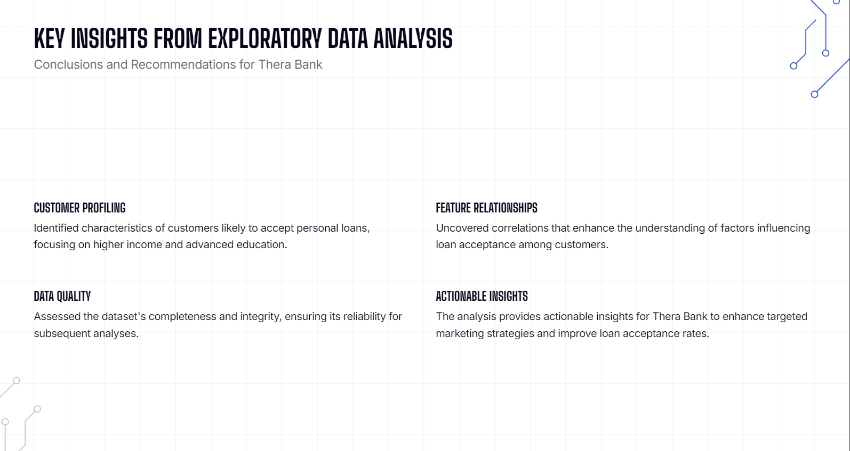

Slide 3
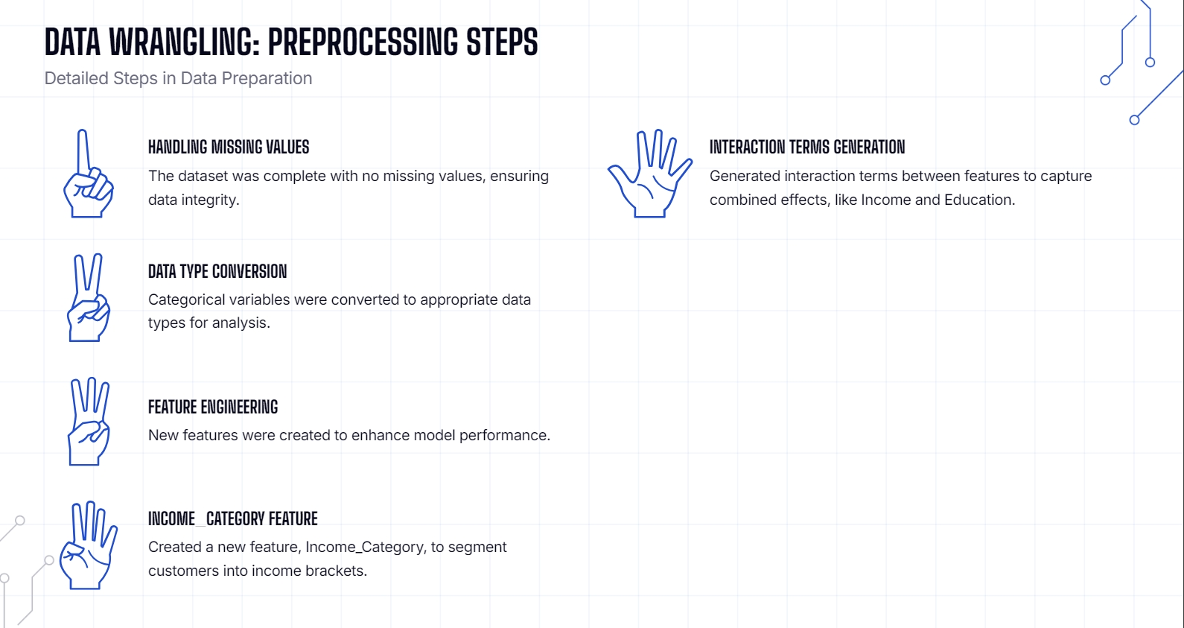

Slide 4
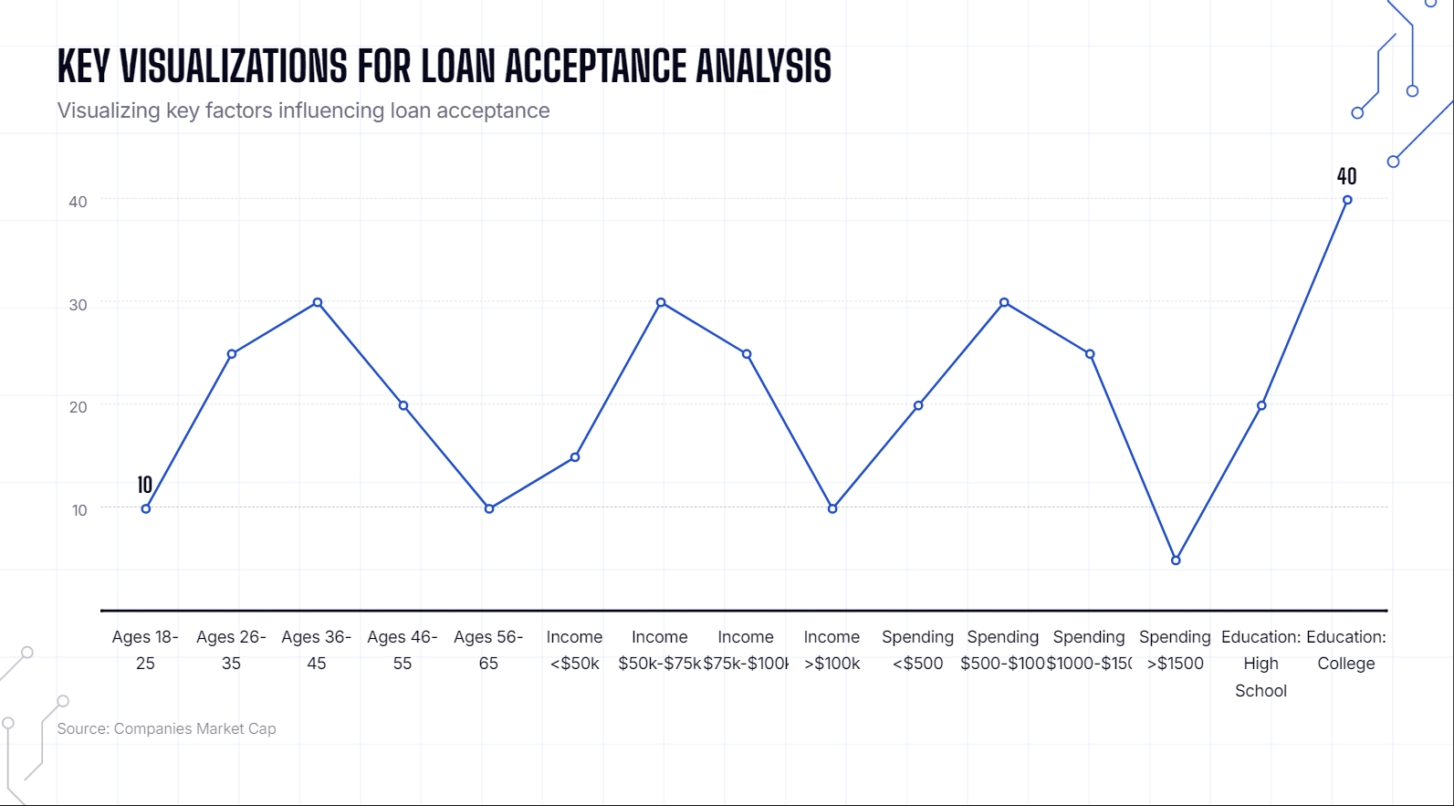

Slide 5
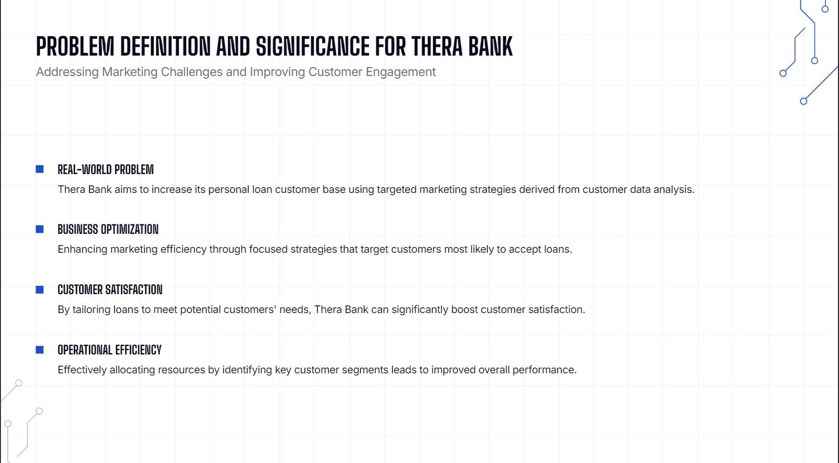

Slide 6
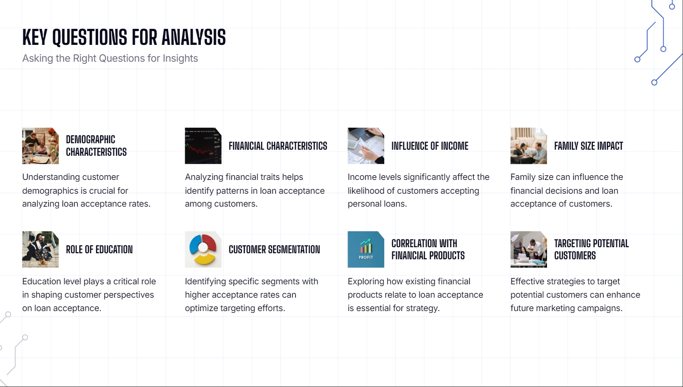

Slide 7
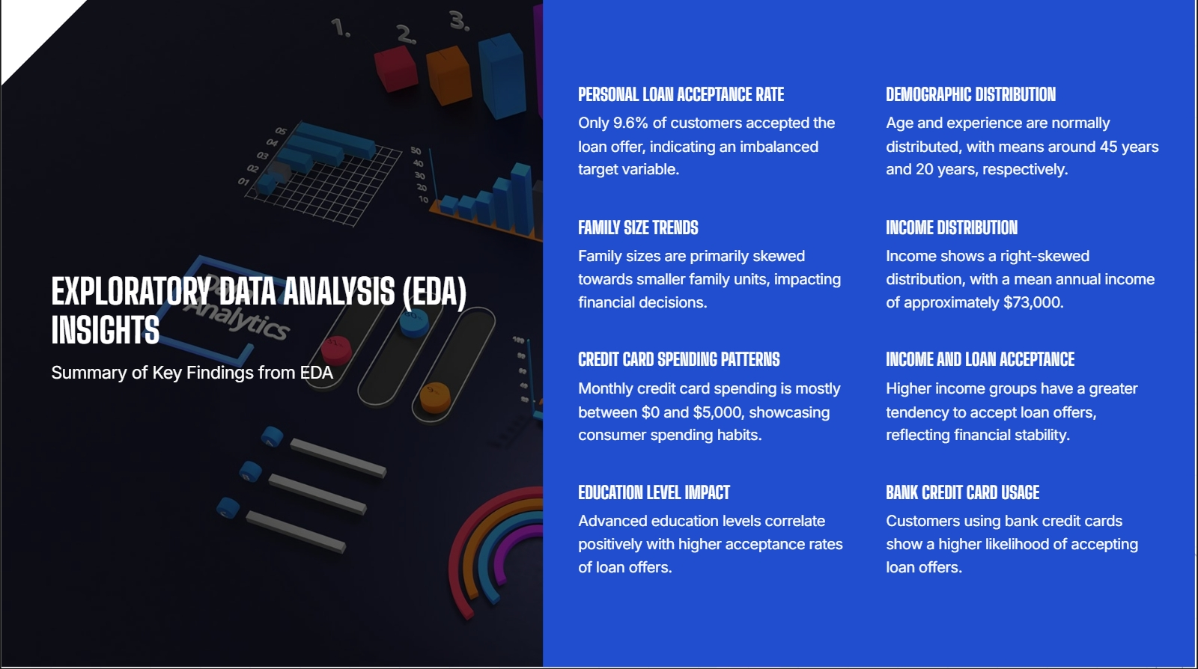

Slide 8
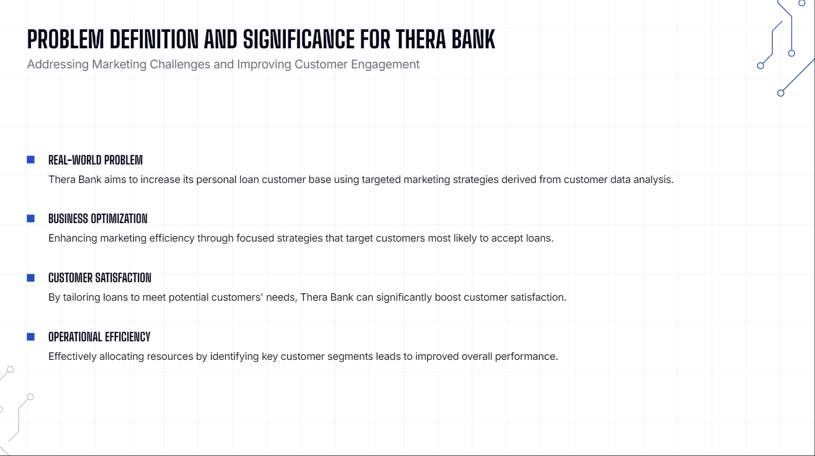

Slide 9
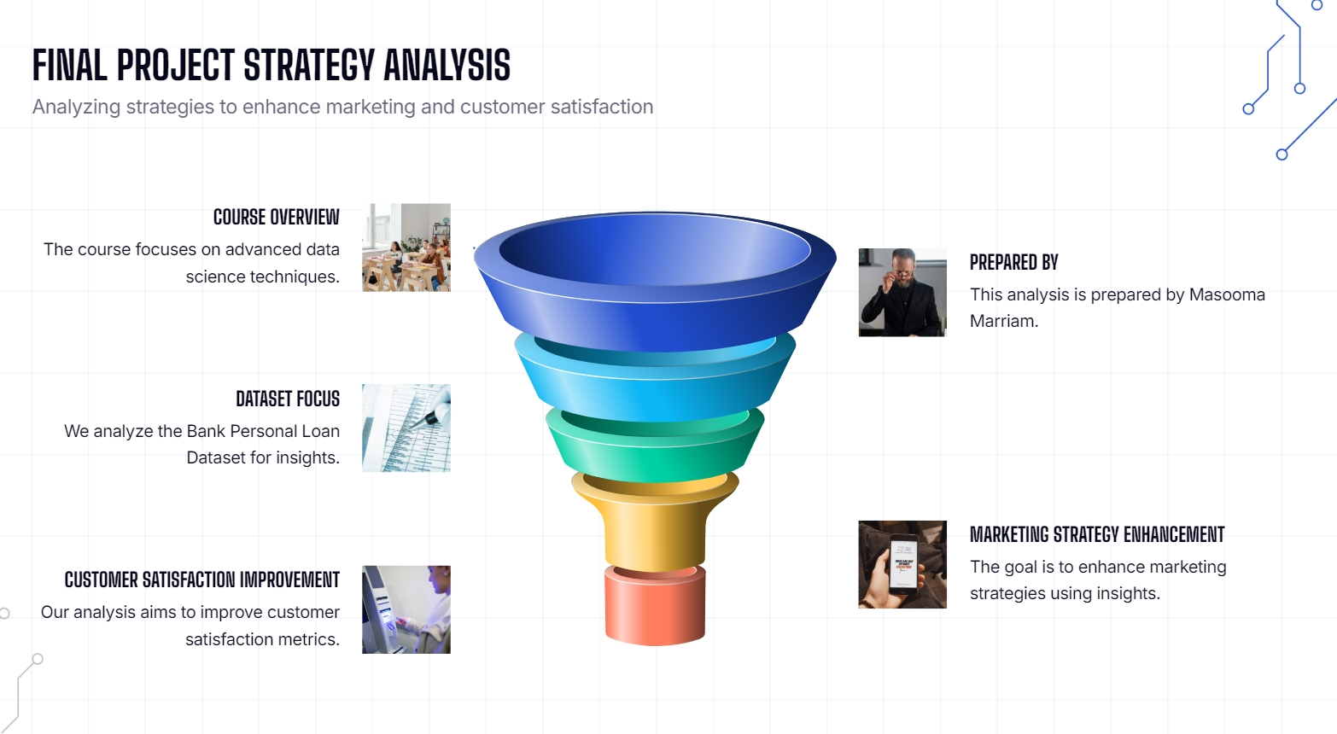

Slide 10


